Slide 1
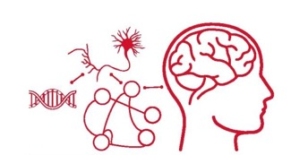


Functional Reconfiguration of a Task-Active Frontoparietal Control Network Facilitates Abstract Reasoning
Tom Morin
Graduate Program for Neuroscience
Henry I. Russek Student Achievement Day
May 6, 2022

Slide 2
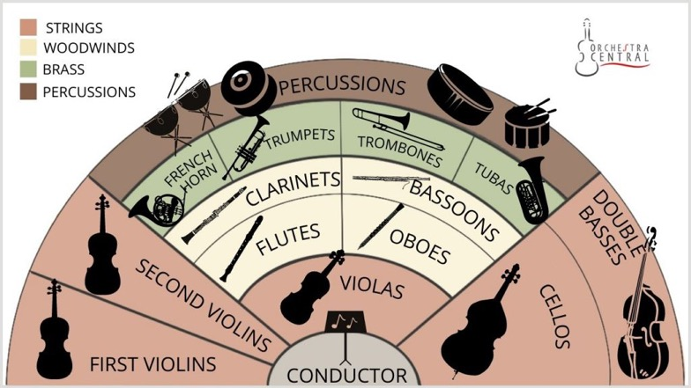
The Brain is Like an Orchestra

Slide 3

Network Reconfiguration in an Orchestra
Warm-up
Song #1
Song #2
Strings
Woodwinds
Brass
Percussion

Slide 4
Guiding Questions
What are the patterns of functional network reconfiguration associated with complex cognition?
Do some networks reconfigure flexibly? Do others remain stable?
How might reconfiguration between rest and task compare to reconfiguration between different tasks?

Slide 5
Simplified Raven’s Progressive Matrices Task

Slide 6
fMRI Scanning Procedure
Resting State
(3 x 6 Minutes)
Task
(6 x 6.5 Minutes)
+

Slide 7
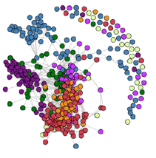
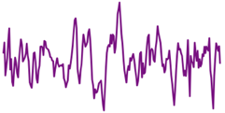
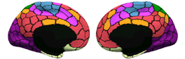
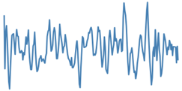
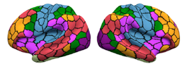

The Brain as a Network
1
2
r
…
400
(Schaefer et al. 2018)
Node: A brain region of interest
Edge: Functional connectivity (correlation) between two nodes
Community: A group of nodes with strong connectivity to each other, and weak connectivity to other communities

Slide 8
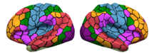
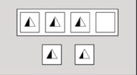
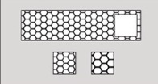
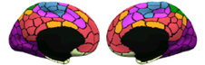
Stable Community Structure Across Reasoning Conditions
Rest
Symbolic
Reasoning

Slide 9
Conclusions
Between rest and task we observed:
A stable network core (default and somatomotor regions)
A flexible community (composed of frontoparietal, dorsal attention, & visual regions) that was fragmented at rest, but became more strongly interconnected during the task
Across all four tasks, we observed a stable community structure.

Slide 10


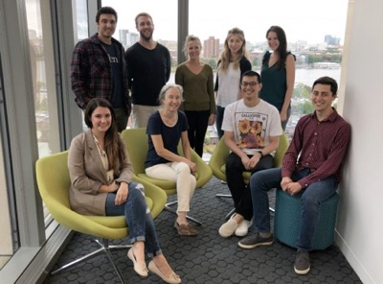
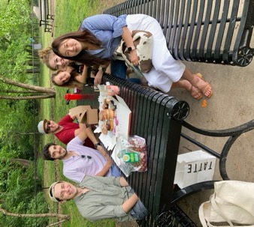
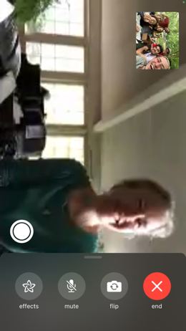
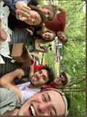
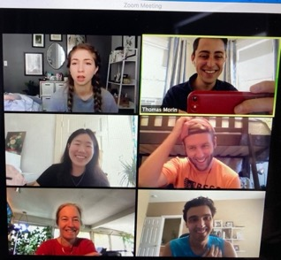
Acknowledgements
Stern Lab Alumni
Allen Chang
Rachel Wehr
Justine Cohen
Weida Ma
Dissertation Advisory Committee
Chantal Stern
Joe McGuire
David Badre
David Somers
Mike Hasselmo
GPN Admin
Shelley Russek
Sandi Grasso
Lavell Blackwell
Stern Lab
Chantal Stern
Matt Dunne
Stamati Liapis
Kylie Moore
Caroline Ahn
Kylie Isenburg
Jing
Cognitive Neuroimaging Center
Stephanie McMains
Shruthi Chakrapani
Funding
NSF Major Research Instrumentation Award 1625552
ONR MURI Award N00014-16-1-2832
ONR DURIP Award N00014-17-1-2304

Slide 11
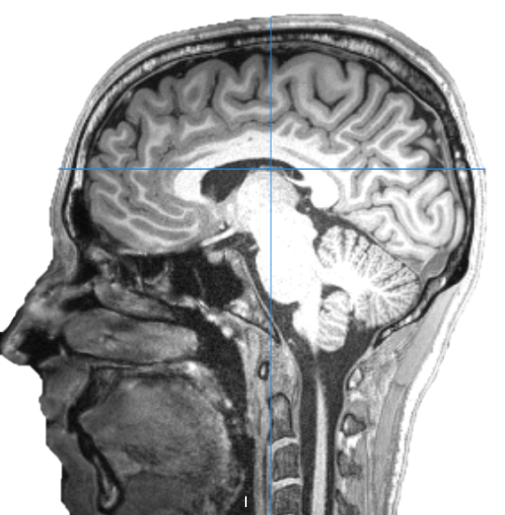
Questions?

